Slide 1
2-1-2022 Meeting

Slide 2
Reduced Chi-Square Values

Slide 3
Reduced Chi-Square Values

Slide 4
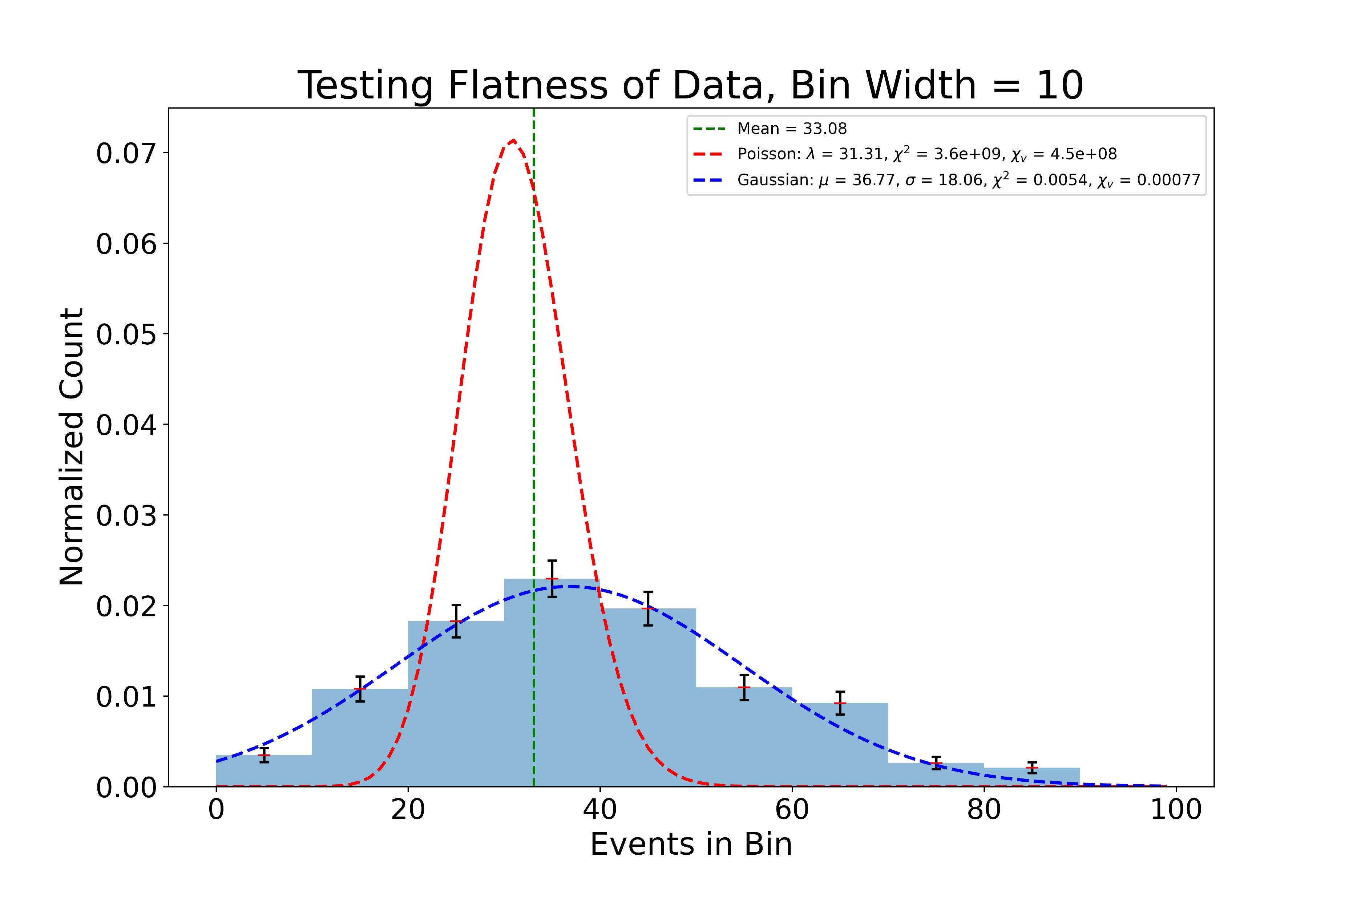

Slide 5
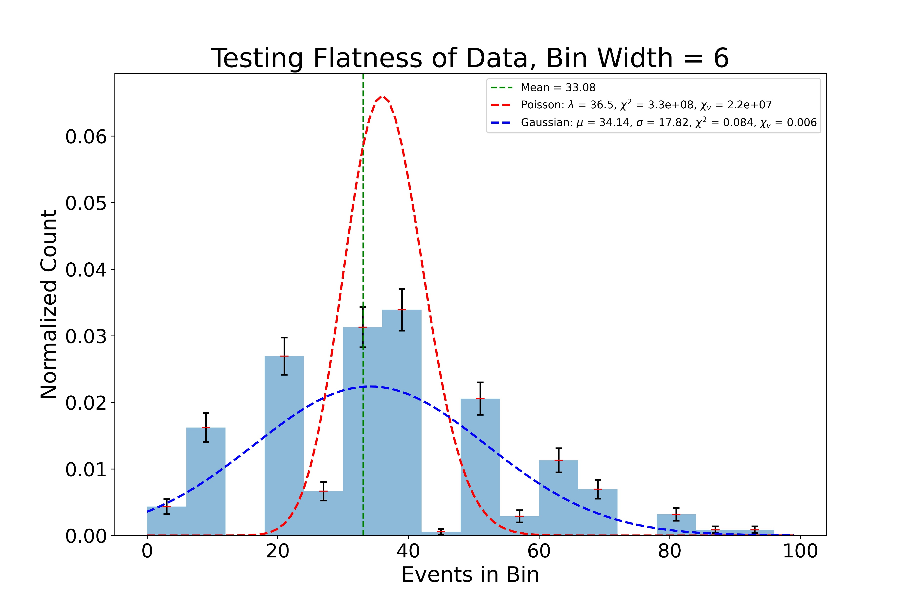

Slide 6
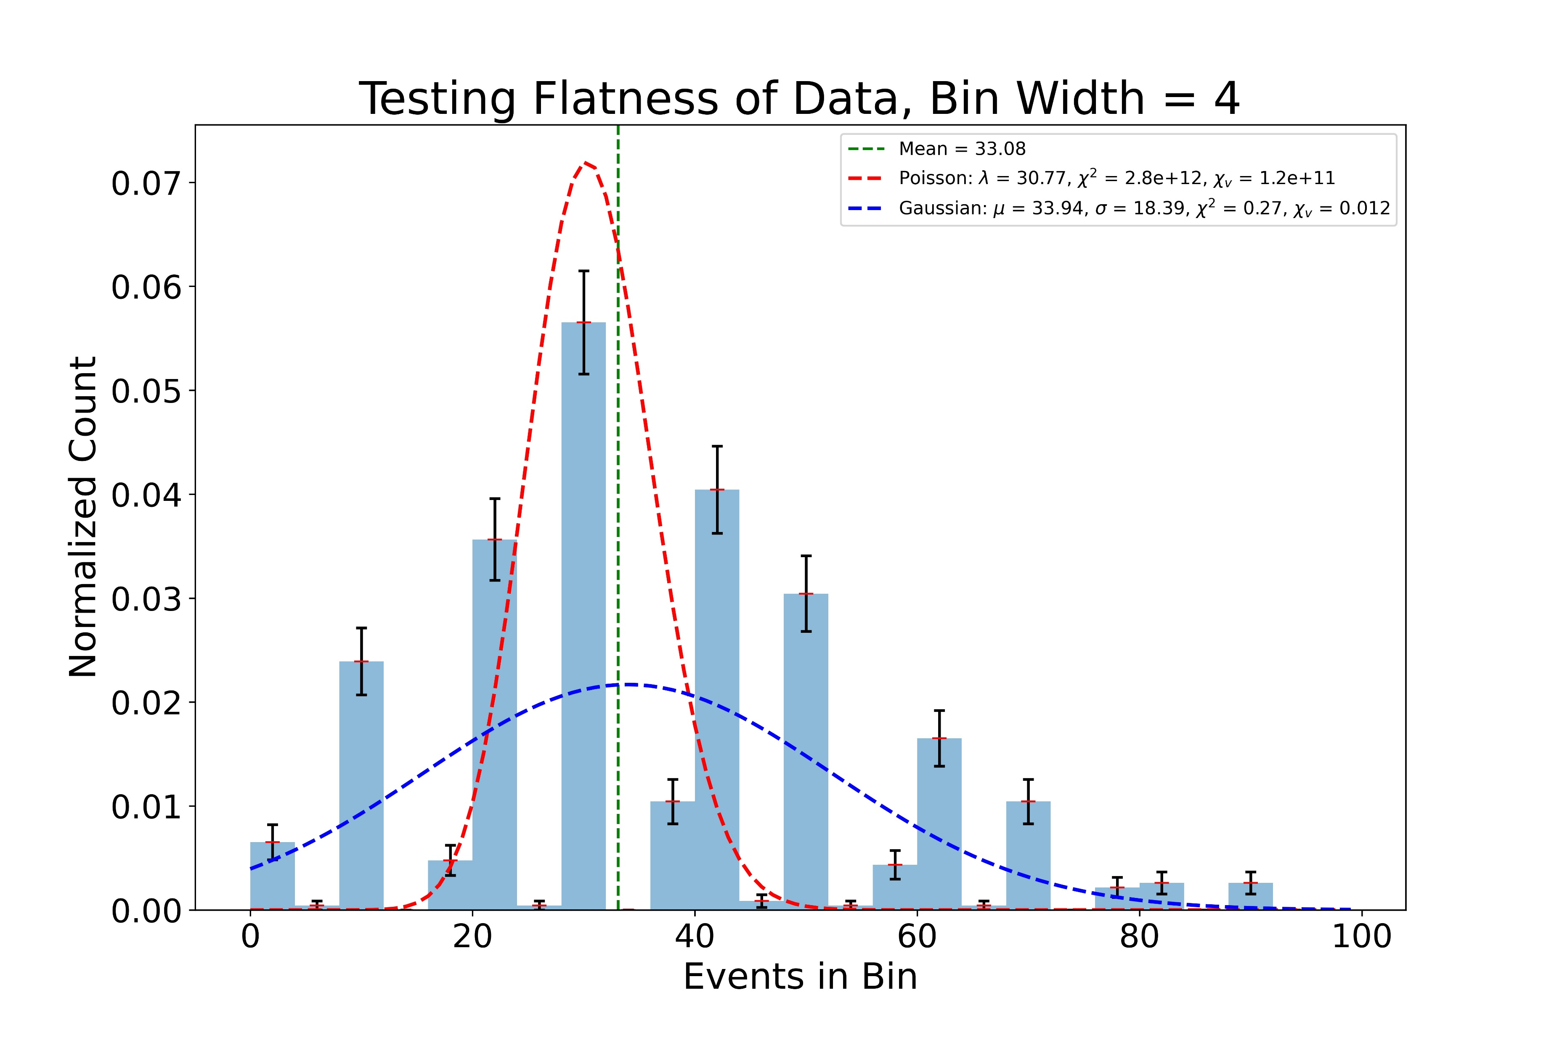

Slide 7
